Slide 1
STT 6300
Chapter 7: Two–Sample Inference

Slide 2
Introduction
Chapter 6 introduced hypothesis testing in the one-sample setting: one sample is obtained from a single population and the sample mean was compared to a hypothesized value of the mean. Practical applications more frequently involve comparing the means of two or more populations. For example:
Compare the mean response of individuals on an experimental drug treatment to those taking a placebo.
Compare birds living near a toxic waste site with birds living in a pristine area.
In this chapter, we introduce the hypothesis testing procedures for comparing two populations. Analysis of variance (ANOVA) is the statistical tool for performing hypothesis testing to comparing more than two means and this is covered in Chapter 9.

Slide 3
Two-Sample t-Test for Independent Samples with Equal Variances
One of the most popular statistical testing procedures is the two sample t-test used for comparing the means of two populations.
Example: A study was conducted to examine the effect of thermal pollution from a treatment plant on Asiatic clams (Corbicula Fluminea) in the water. A sample of clams was collected at the intake site where there was no thermal pollution and at a discharge site where there was thermal pollution. On of the variables that was measured on the length of the clams (in cm). The goal of the study was to determine if the thermal pollution was adversely affecting the growth of the clams and leading to smaller sizes on average. (Data collected by J. Booker, 1997.)

Slide 4
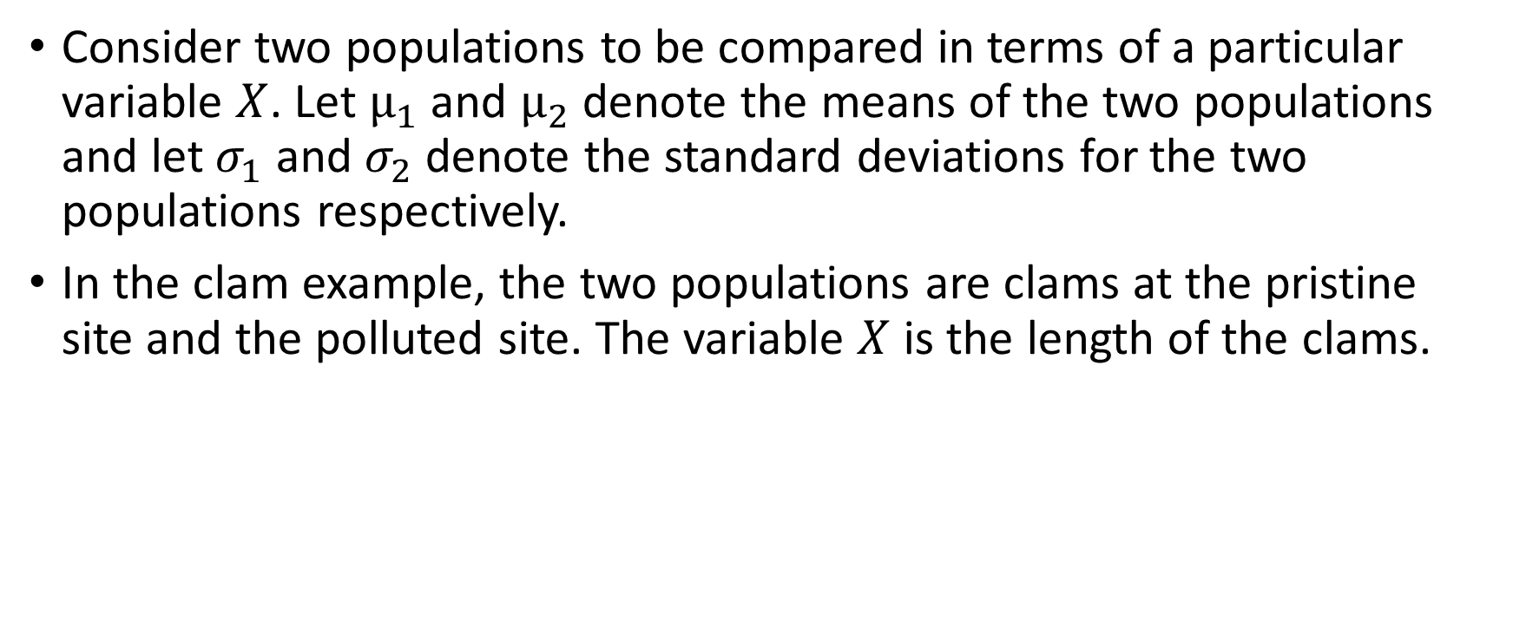
Two-Sample t-Test for Independent Samples with Equal Variances
Consider two populations to be compared in terms of a particular variable $X$. Let $µ_{1}$ and $µ_{2}$ denote the means of the two populations and let $σ_{1}$ and $σ_{2}$ denote the standard deviations for the two populations respectively.
In the clam example, the two populations are clams at the pristine site and the polluted site. The variable $X$ is the length of the clams.

Slide 5
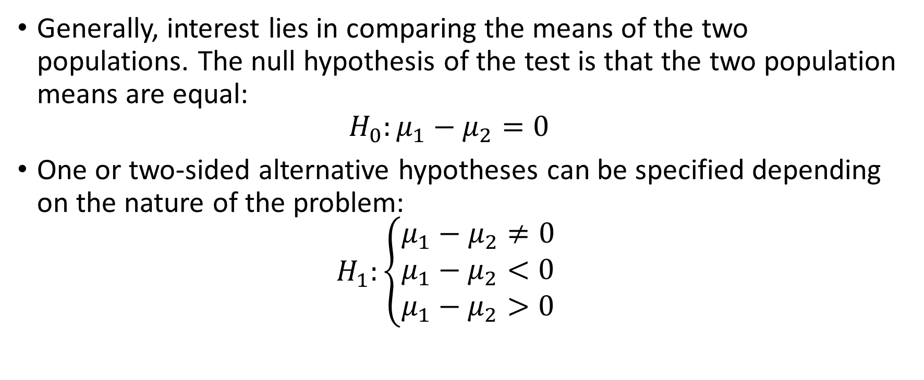
Two-Sample t-Test for Independent Samples with Equal Variances
Generally, interest lies in comparing the means of the two populations. The null hypothesis of the test is that the two population means are equal: $H_{0}:μ_{1}−μ_{2}=0$
One or two-sided alternative hypotheses can be specified depending on the nature of the problem: $H_{1}:\left\{\begin{aligned}μ_{1}−μ_{2}≠0 \\ μ_{1}−μ_{2}<0 \\ μ_{1}−μ_{2}>0 \end{aligned}\right.$

Slide 6
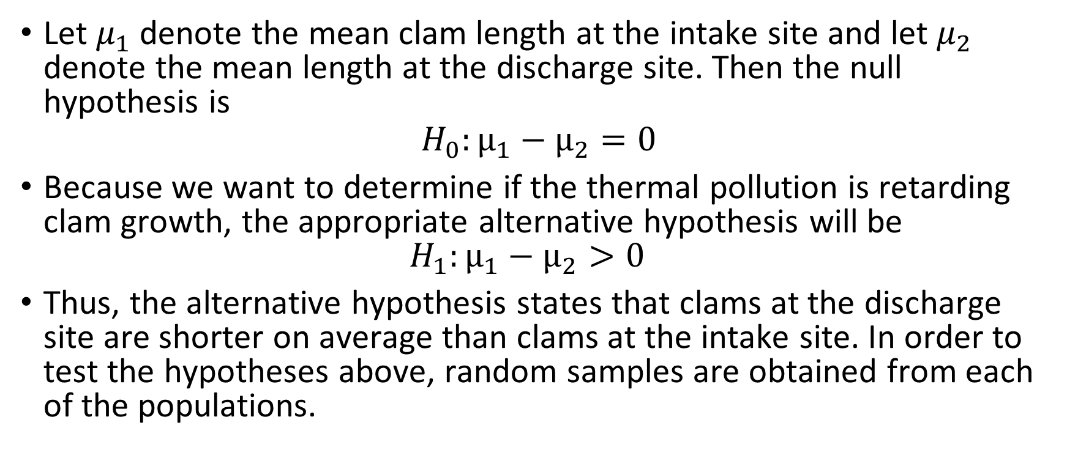
Clam Example
Let $μ_{1}$ denote the mean clam length at the intake site and let $μ_{2}$ denote the mean length at the discharge site. Then the null hypothesis is
$$H_{0}:µ_{1}−µ_{2}=0$$
Because we want to determine if the thermal pollution is retarding clam growth, the appropriate alternative hypothesis will be $H_{1}:µ_{1}−µ_{2}>0$
Thus, the alternative hypothesis states that clams at the discharge site are shorter on average than clams at the intake site. In order to test the hypotheses above, random samples are obtained from each of the populations.

Slide 7
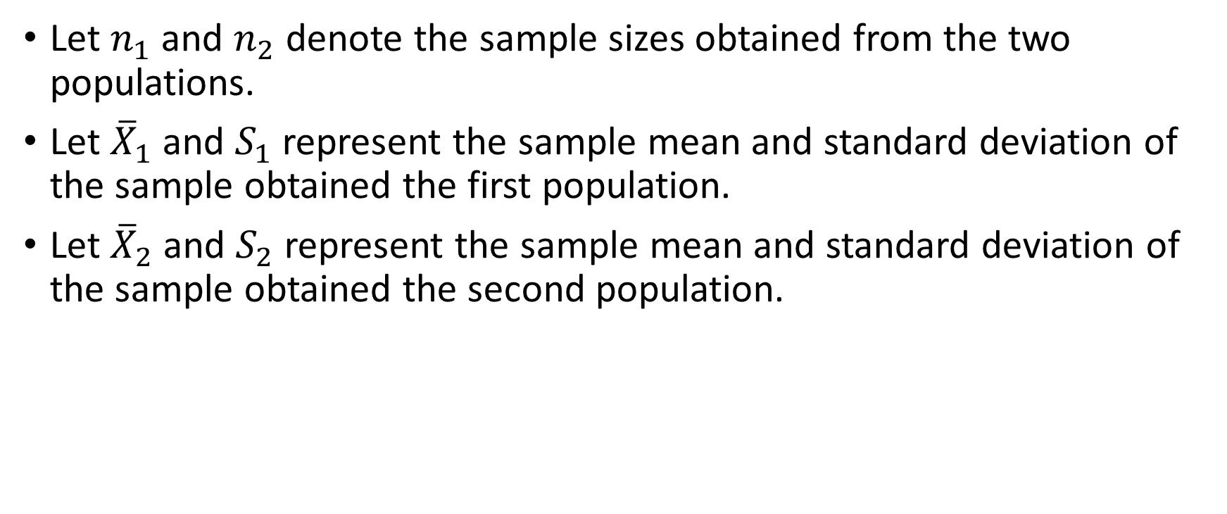
Notation
Let $n_{1}$ and $n_{2}$ denote the sample sizes obtained from the two populations.
Let ${\overline{X}}_{1}$ and $S_{1}$ represent the sample mean and standard deviation of the sample obtained the first population.
Let ${\overline{X}}_{2}$ and $S_{2}$ represent the sample mean and standard deviation of the sample obtained the second population.

Slide 8
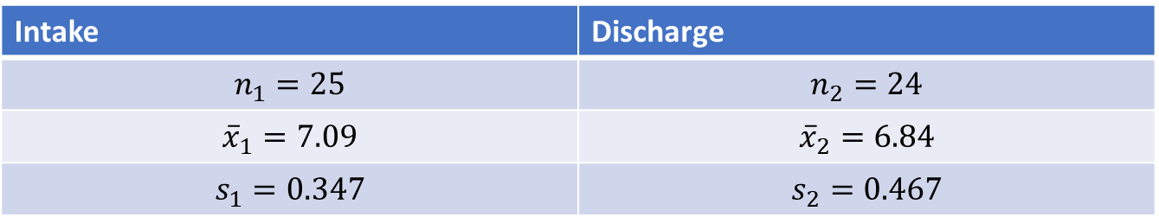

Clam Example
For the clam data, we have:
The mean length of the $n=24$ clams at the discharge site is less than the mean length of the $n=25$ clams at the intake site. The question of interest is whether or not this difference is statistically significant.
Intake | Discharge
$$n_{1}=25$$ | $$n_{2}=24$$
$${\overline{x}}_{1}=7.09$$ | $${\overline{x}}_{2}=6.84$$
$$s_{1}=0.347$$ | $$s_{2}=0.467$$

Slide 9
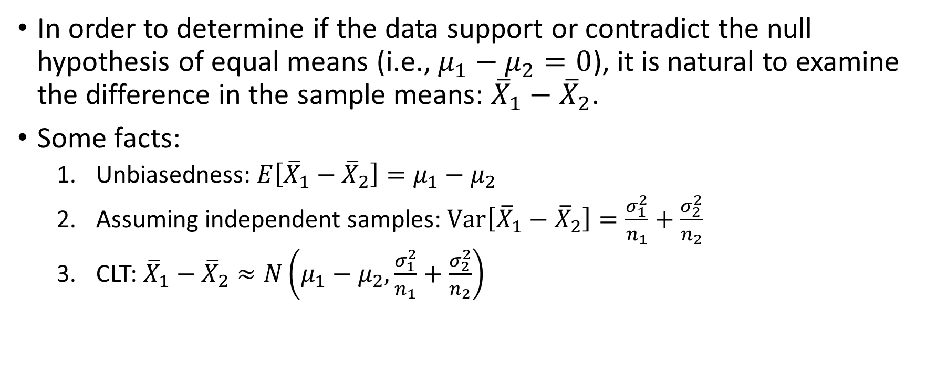
Two-Sample t-Test for Independent Samples with Equal Variances
In order to determine if the data support or contradict the null hypothesis of equal means (i.e., $μ_{1}−μ_{2}=0$), it is natural to examine the difference in the sample means: ${\overline{X}}_{1}−{\overline{X}}_{2}$.
Some facts:
Unbiasedness: $E\left[{\overline{X}}_{1}−{\overline{X}}_{2}\right]=μ_{1}−μ_{2}$
Assuming independent samples: $Var\left[{\overline{X}}_{1}−{\overline{X}}_{2}\right]=\frac{σ_{1}^{2}}{n_{1}}+\frac{σ_{2}^{2}}{n_{2}}$
CLT: ${\overline{X}}_{1}−{\overline{X}}_{2}≈N\left(μ_{1}−μ_{2},\frac{σ_{1}^{2}}{n_{1}}+\frac{σ_{2}^{2}}{n_{2}}\right)$

Slide 10
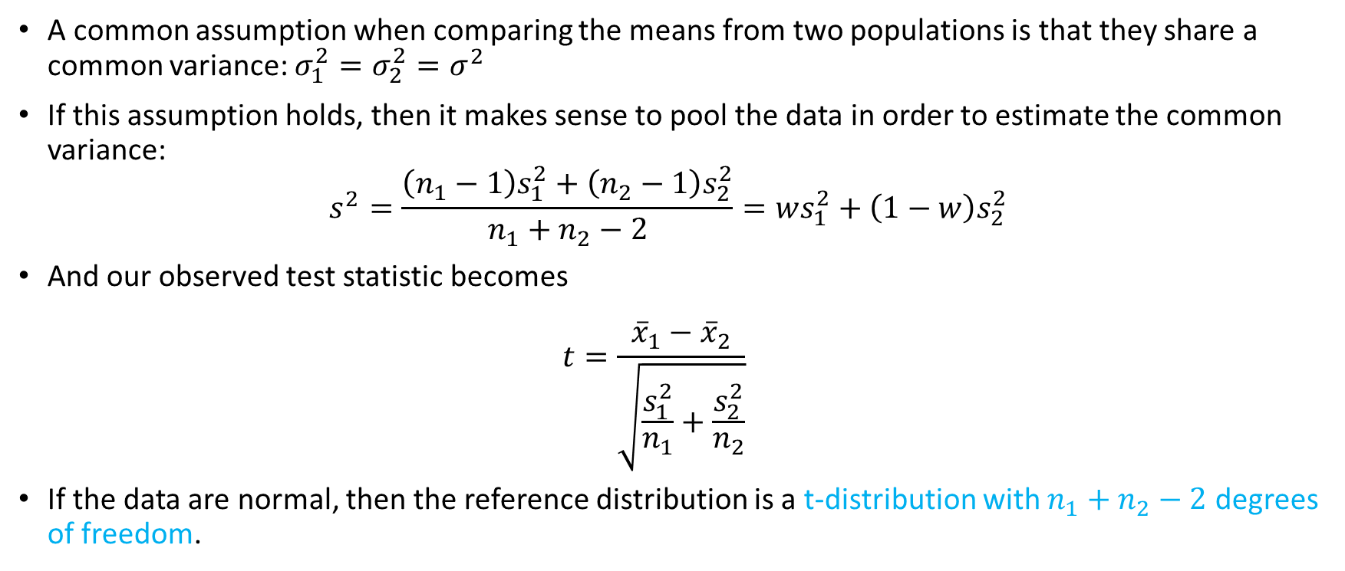
Two-Sample t-Test for Independent Samples with Equal Variances
A common assumption when comparing the means from two populations is that they share a common variance: $σ_{1}^{2}=σ_{2}^{2}=σ^{2}$
If this assumption holds, then it makes sense to pool the data in order to estimate the common variance:
$$s^{2}=\frac{\left(n_{1}−1\right)s_{1}^{2}+\left(n_{2}−1\right)s_{2}^{2}}{n_{1}+n_{2}−2}=ws_{1}^{2}+\left(1−w\right)s_{2}^{2}$$
And our observed test statistic becomes $t=\frac{{\overline{x}}_{1}−{\overline{x}}_{2}}{\sqrt{\frac{s_{1}^{2}}{n_{1}}+\frac{s_{2}^{2}}{n_{2}}}}$
If the data are normal, then the reference distribution is a t-distribution with $n_{1}+n_{2}−2$ degrees of freedom.

Slide 11
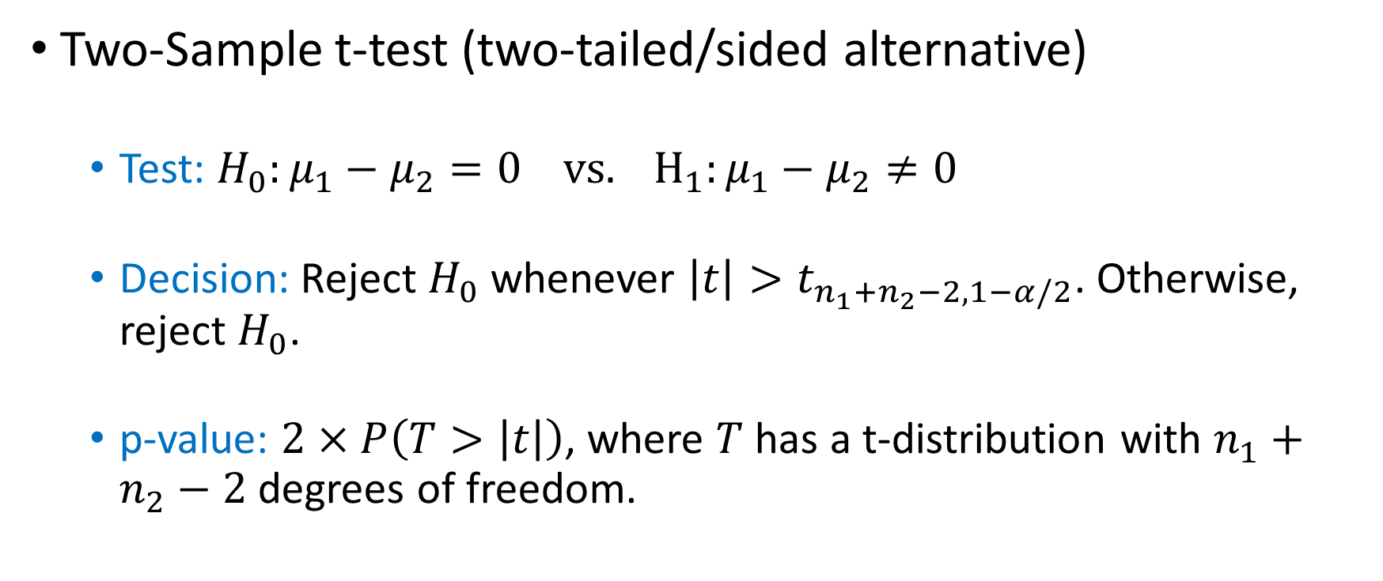
Two-Sample t-Test for Independent Samples with Equal Variances
Two-Sample t-test (two-tailed/sided alternative)
Test: $H_{0}:μ_{1}−μ_{2}=0 vs. H_{1}:μ_{1}−μ_{2}≠0$
Decision: Reject $H_{0}$ whenever $\left|t\right|>t_{n_{1}+n_{2}−2,1−α/2}$. Otherwise, reject $H_{0}$.
p-value: $2×P\left(T>\left|t\right|\right)$, where $T$ has a t-distribution with $n_{1}+n_{2}−2$ degrees of freedom.

Slide 12
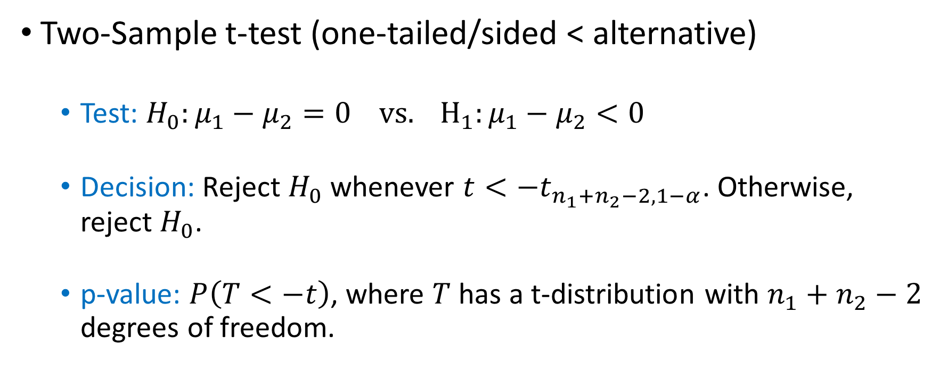
Two-Sample t-Test for Independent Samples with Equal Variances
Two-Sample t-test (one-tailed/sided < alternative)
Test: $H_{0}:μ_{1}−μ_{2}=0 vs. H_{1}:μ_{1}−μ_{2}<0$
Decision: Reject $H_{0}$ whenever $t<{−t}_{n_{1}+n_{2}−2,1−α}$. Otherwise, reject $H_{0}$.
p-value: $P\left(T<−t\right)$, where $T$ has a t-distribution with $n_{1}+n_{2}−2$ degrees of freedom.

Slide 13
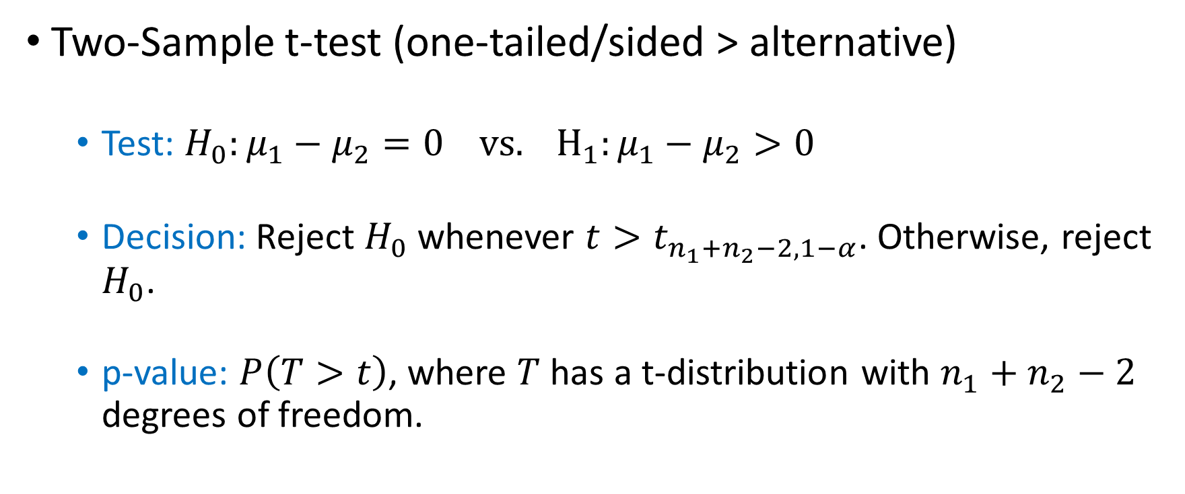
Two-Sample t-Test for Independent Samples with Equal Variances
Two-Sample t-test (one-tailed/sided > alternative)
Test: $H_{0}:μ_{1}−μ_{2}=0 vs. H_{1}:μ_{1}−μ_{2}>0$
Decision: Reject $H_{0}$ whenever $t>t_{n_{1}+n_{2}−2,1−α}$. Otherwise, reject $H_{0}$.
p-value: $P\left(T>t\right)$, where $T$ has a t-distribution with $n_{1}+n_{2}−2$ degrees of freedom.

Slide 14
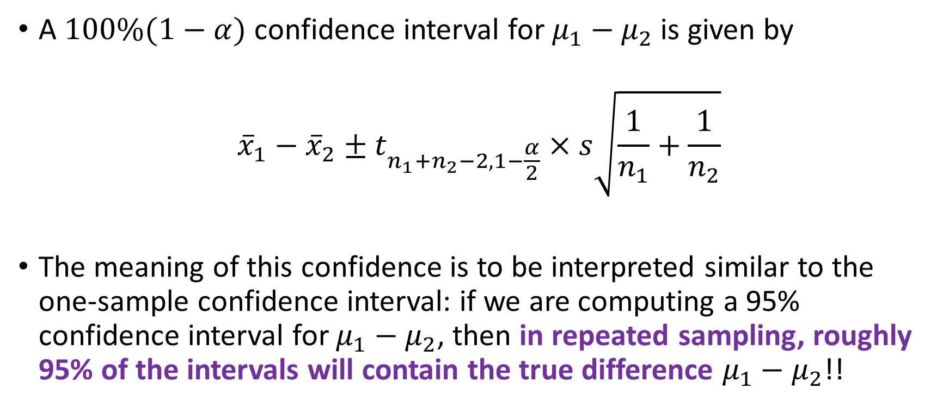
Two-Sample t-Test for Independent Samples with Equal Variances
A $100\%(1−α)$ confidence interval for $μ_{1}−μ_{2}$ is given by
$${\overline{x}}_{1}−{\overline{x}}_{2}±t_{n_{1}+n_{2}−2,1−\frac{α}{2}}×s\sqrt{\frac{1}{n_{1}}+\frac{1}{n_{2}}}$$
The meaning of this confidence is to be interpreted similar to the one-sample confidence interval: if we are computing a 95% confidence interval for $μ_{1}−μ_{2}$, then in repeated sampling, roughly 95% of the intervals will contain the true difference $μ_{1}−μ_{2}$!!

Slide 15
Two-Sample t-Test for Independent Samples with Equal Variances
The tests and confidence interval just described are appropriate under the following assumptions:
Independent random samples. (This is the most important assumption!)
Normality.
Equal variance.
A common rule of thumb is that the equal variance assumption is plausible if the larger sample standard deviation is no more than twice the smaller sample standard deviation. If the equal variance assumption is not satisfied, we have to make a slight modification to the two-sample t-test procedure we just covered.

Slide 16

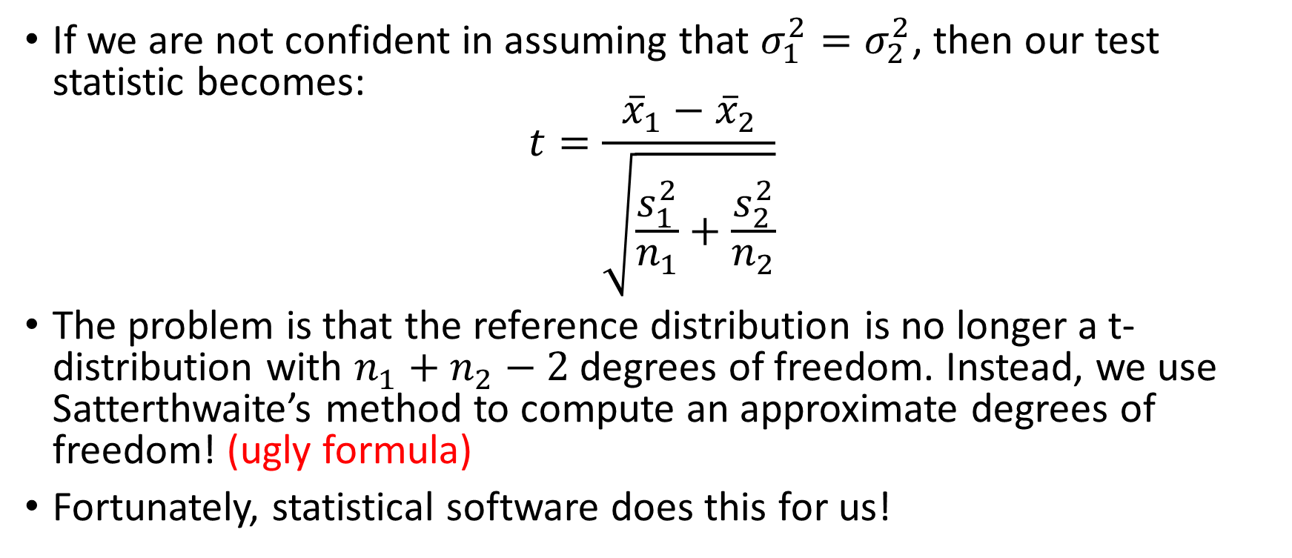
Two-Sample t-Test for Independent Samples with Unequal Variances
If we are not confident in assuming that $σ_{1}^{2}=σ_{2}^{2}$, then our test statistic becomes:
$$t=\frac{{\overline{x}}_{1}−{\overline{x}}_{2}}{\sqrt{\frac{s_{1}^{2}}{n_{1}}+\frac{s_{2}^{2}}{n_{2}}}}$$
The problem is that the reference distribution is no longer a t-distribution with $n_{1}+n_{2}−2$ degrees of freedom. Instead, we use Satterthwaite’s method to compute an approximate degrees of freedom! (ugly formula)
Fortunately, statistical software does this for us!

Slide 17
Clam Example
clams.R
Read the section More General Hypotheses

Slide 18
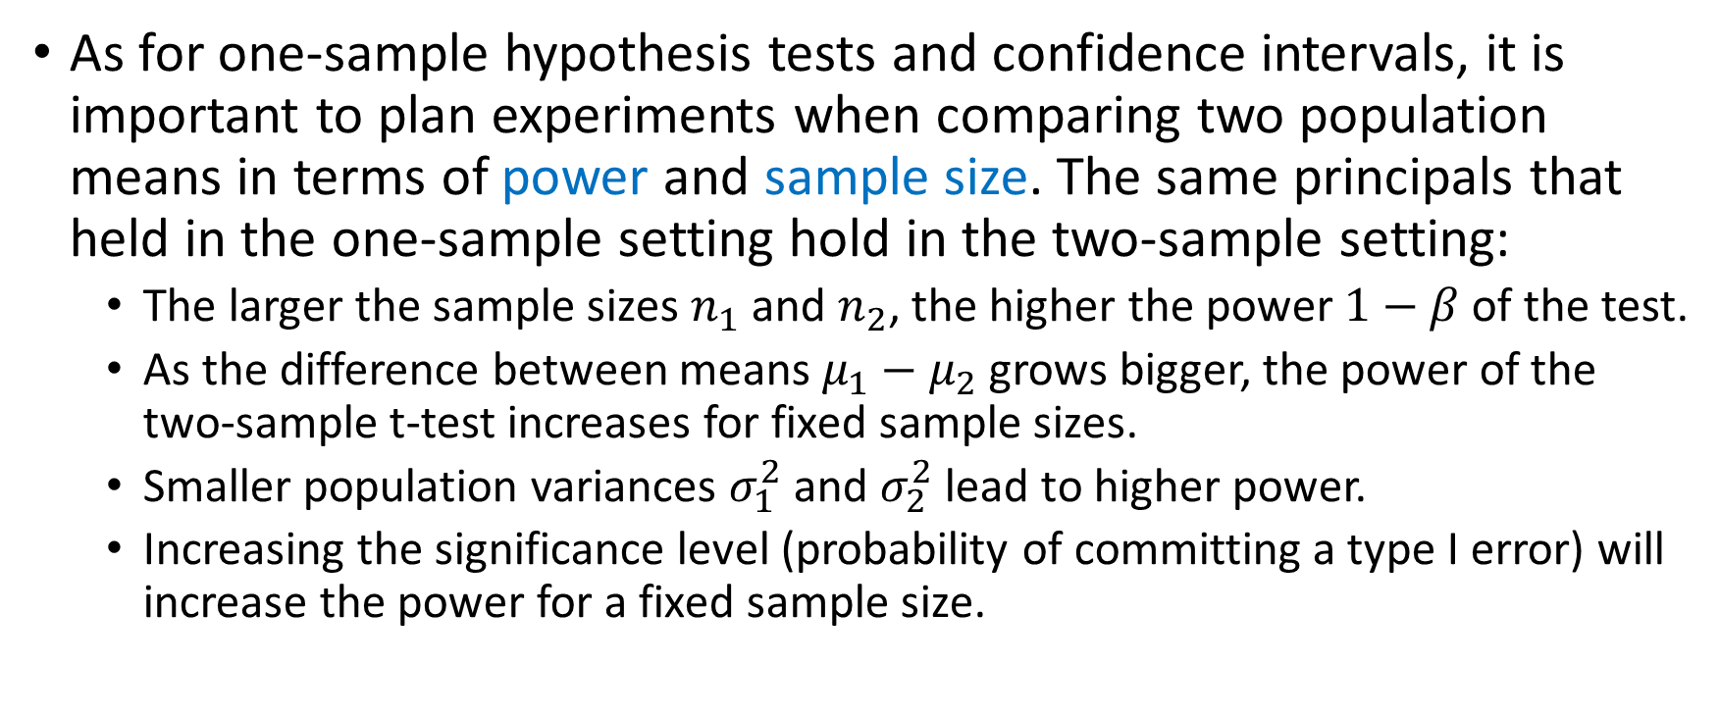
Sample Size and Power When Comparing Two Means
As for one-sample hypothesis tests and confidence intervals, it is important to plan experiments when comparing two population means in terms of power and sample size. The same principals that held in the one-sample setting hold in the two-sample setting:
The larger the sample sizes $n_{1}$ and $n_{2}$, the higher the power $1−β$ of the test.
As the difference between means $μ_{1}−μ_{2}$ grows bigger, the power of the two-sample t-test increases for fixed sample sizes.
Smaller population variances $σ_{1}^{2}$ and $σ_{2}^{2}$ lead to higher power.
Increasing the significance level (probability of committing a type I error) will increase the power for a fixed sample size.

Slide 19

Sample Size Formula When Comparing Two Means (Two-Sided Test)
$$n=\frac{\left(σ_{1}^{2}+σ_{2}^{2}\right)\left(z_{1−\frac{α}{2}}+z_{1−β}\right)}{Δ^{2}}$$
Where
$$Δ=\left|μ_{1}−μ_{2}\right|$$

Slide 20
Nonparametric Tests
The t-test procedures (one- or two-sample) rely on the normality assumption.
Since the t-test assumes a parametric form for the underlying distribution(s), it is called a parametric test.
Fortunately, the t-test is quite robust to modest deviations from normality.
For more severe violations of the normality assumption, nonparametric tests can be used!
Such nonparametric tests do not require that the underlying distribution(s) belong to a particular parametric family.
Nonparametric tests are typically based on the relative ranks of the sample observations.

Slide 21
Nonparametric Tests
Scenario | Parametric test | Nonparametric test
One-sample | One-sample t-test | Wilcoxon signed rank test
Two-sample | Two-sample t-test | Wilcoxon rank sum test
Paired data | Paired t-test | Wilcoxon signed rank test, sign test
More than two samples | ANOVA/F-test | Kruskal-Wallis test

Slide 22
Paired t-test
A clinical trial is to be run to test the medication captopril for the treatment of hypertension.
How should the study be designed?
One possibility would be to enroll subjects in the study and randomly assign subjects to one of two treatments: captopril or placebo.
Once the experiment is over, the data could be analyzed using a simple two-sample t-test to determine if captopril significantly differs from the placebo.
However, in experiments like this, there tends to be a lot of between subject variability.
If the actual effect of the captopril on blood pressure is small relative to this between subject variability, then the two-sample t-test may not be able to detect the drug’s effect!!
Is there a better way to design the study?

Slide 23
Paired t-test
One way to factor out such variability is to use each subject as their own control!
In other words, we could take each subjects blood pressure before and after taking the drug.
We could then perform our analysis on the paired differences (i.e., after – before).
Large negative differences would be evidence against the null hypothesis (i.e., no effect).

Slide 24
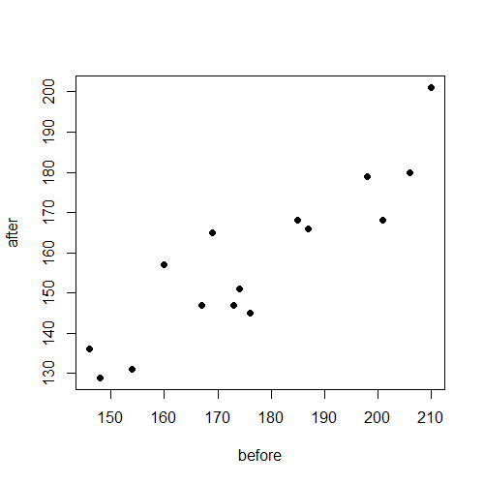
Paired t-Test
Before | After | Difference
210 | 201 | 9
169 | 165 | 4
187 | 166 | 21
160 | 157 | 3
167 | 147 | 20
176 | 145 | 31
185 | 168 | 17
206 | 180 | 26
173 | 147 | 26
146 | 136 | 10
174 | 151 | 23
201 | 168 | 33
198 | 179 | 19
148 | 129 | 19
154 | 131 | 23

Slide 25
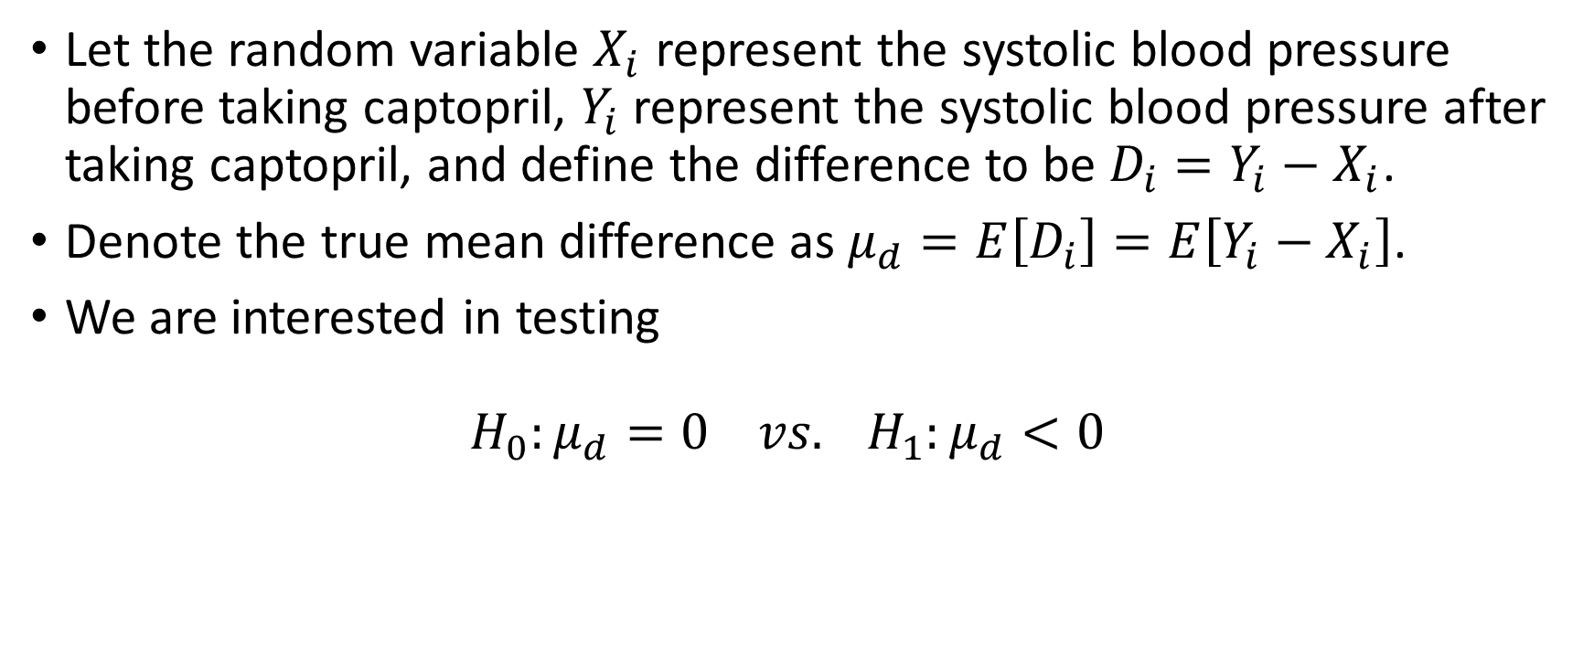
Paired t-test
Let the random variable $X_{i}$ represent the systolic blood pressure before taking captopril, $Y_{i}$ represent the systolic blood pressure after taking captopril, and define the difference to be $D_{i}=Y_{i}−X_{i}$.
Denote the true mean difference as $μ_{d}=E\left[D_{i}\right]=E\left[Y_{i}−X_{i}\right]$.
We are interested in testing $H_{0}:μ_{d}=0 vs. H_{1}:μ_{d}<0$

Slide 26
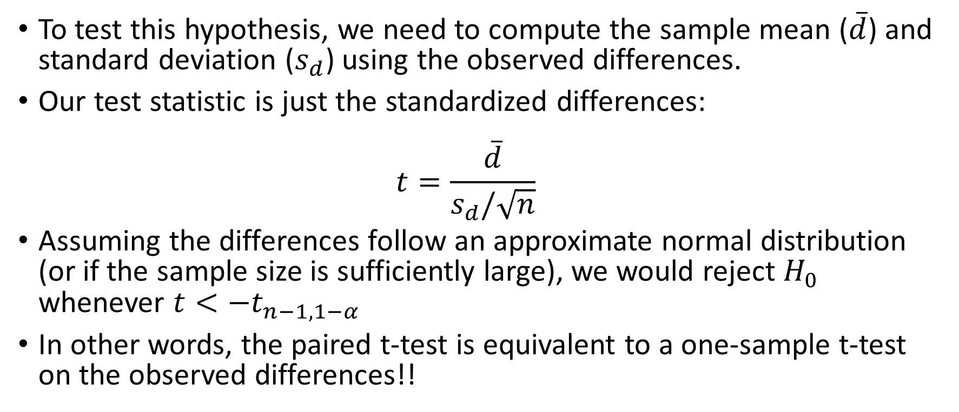
Paired t-test
To test this hypothesis, we need to compute the sample mean ($\overline{d}$) and standard deviation ($s_{d}$) using the observed differences.
Our test statistic is just the standardized differences: $t=\frac{\overline{d}}{s_{d}/\sqrt{n}}$
Assuming the differences follow an approximate normal distribution (or if the sample size is sufficiently large), we would reject $H_{0}$ whenever $t<−t_{n−1, 1−α}$
In other words, the paired t-test is equivalent to a one-sample t-test on the observed differences!!

Slide 27
Questions?
Read chapter 7!!

